Slide 1
Open Safari on your iPad
How to figure what to type into safari:
Examples:
mhs202.malverneschools.org – If you are in room 202
mhs204.malverneschools.org – If you are in room 204
mhs206.malverneschools.org – If you are in room 206
mhs***.malverneschools.org - *** is your room number

Slide 2
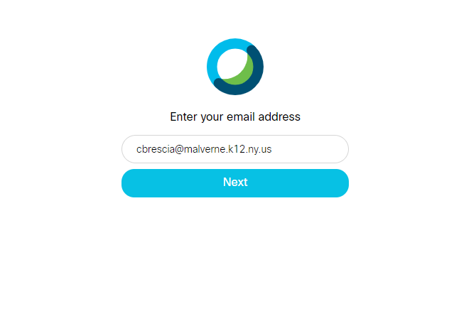
Type your email address in here and click NEXT

Slide 3
Type your email address and password here

Slide 4
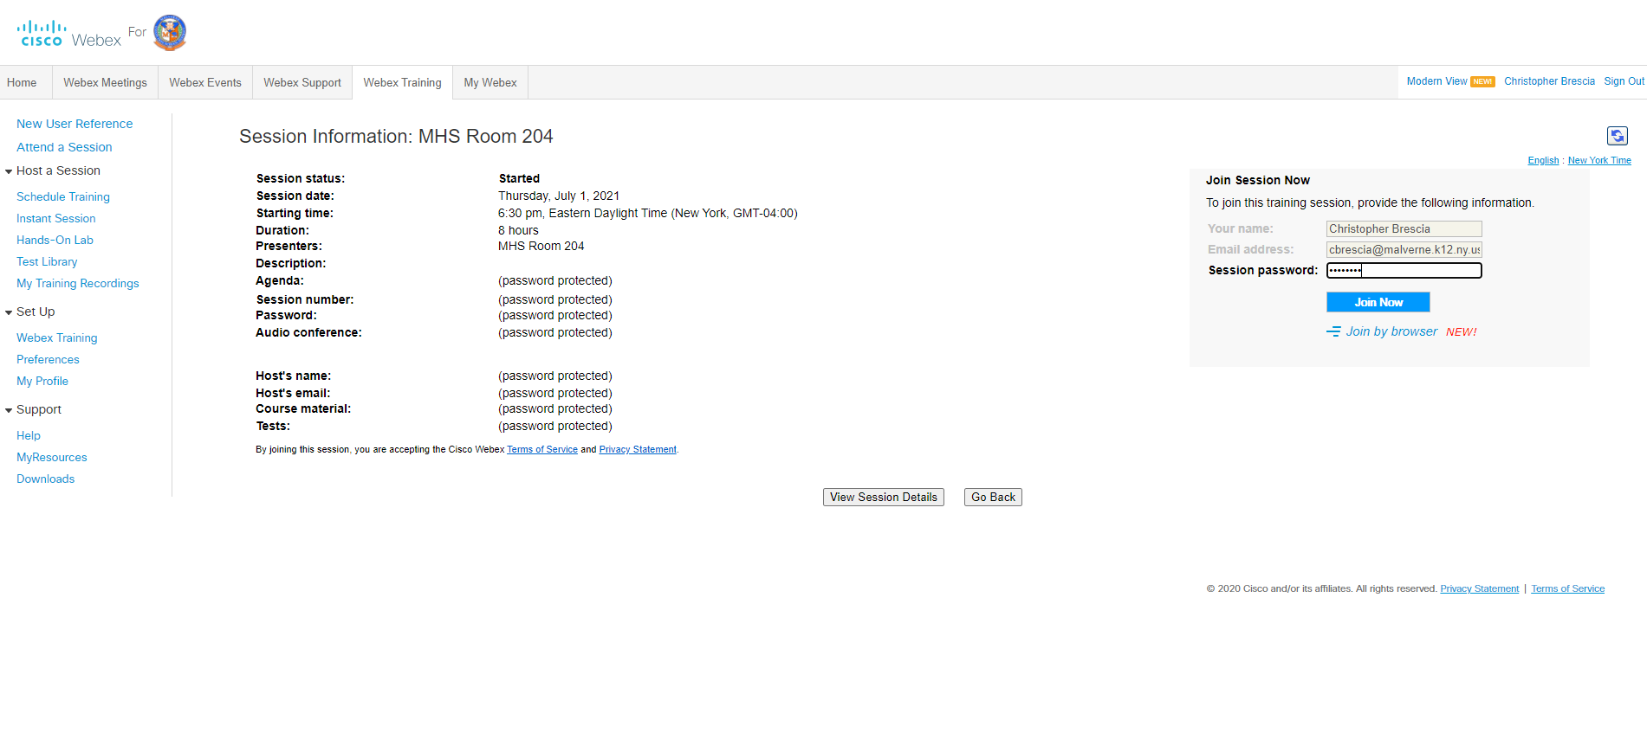
The password is malverne

Slide 5
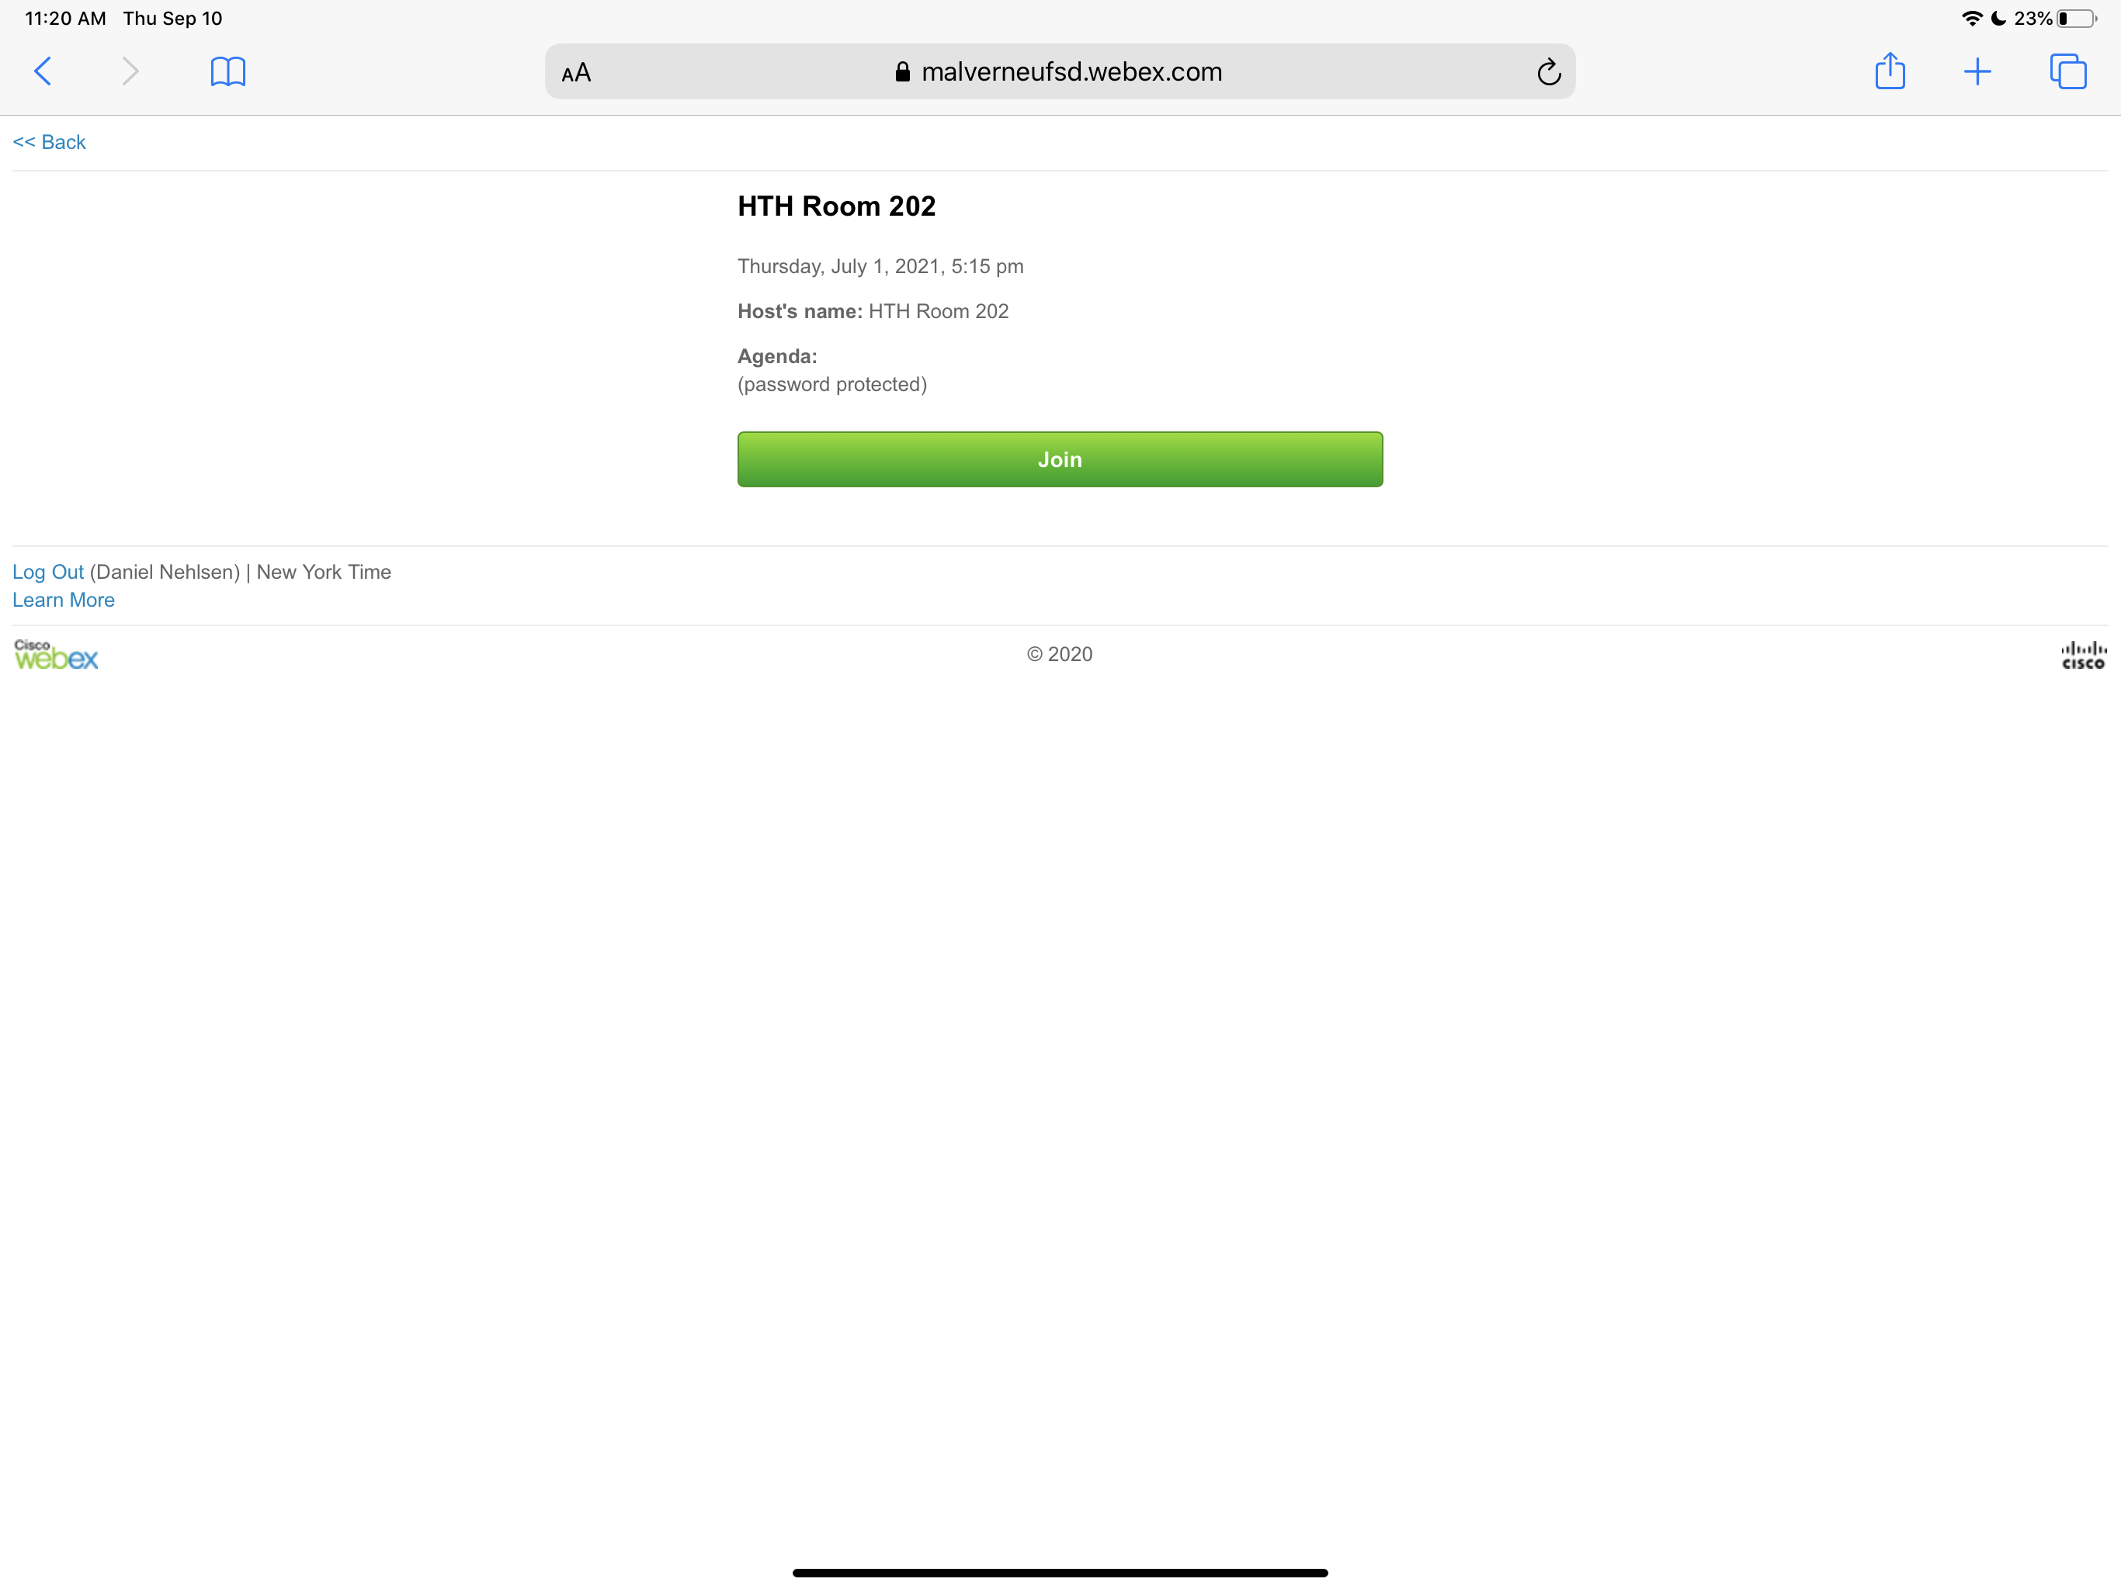
Click Join

Slide 6
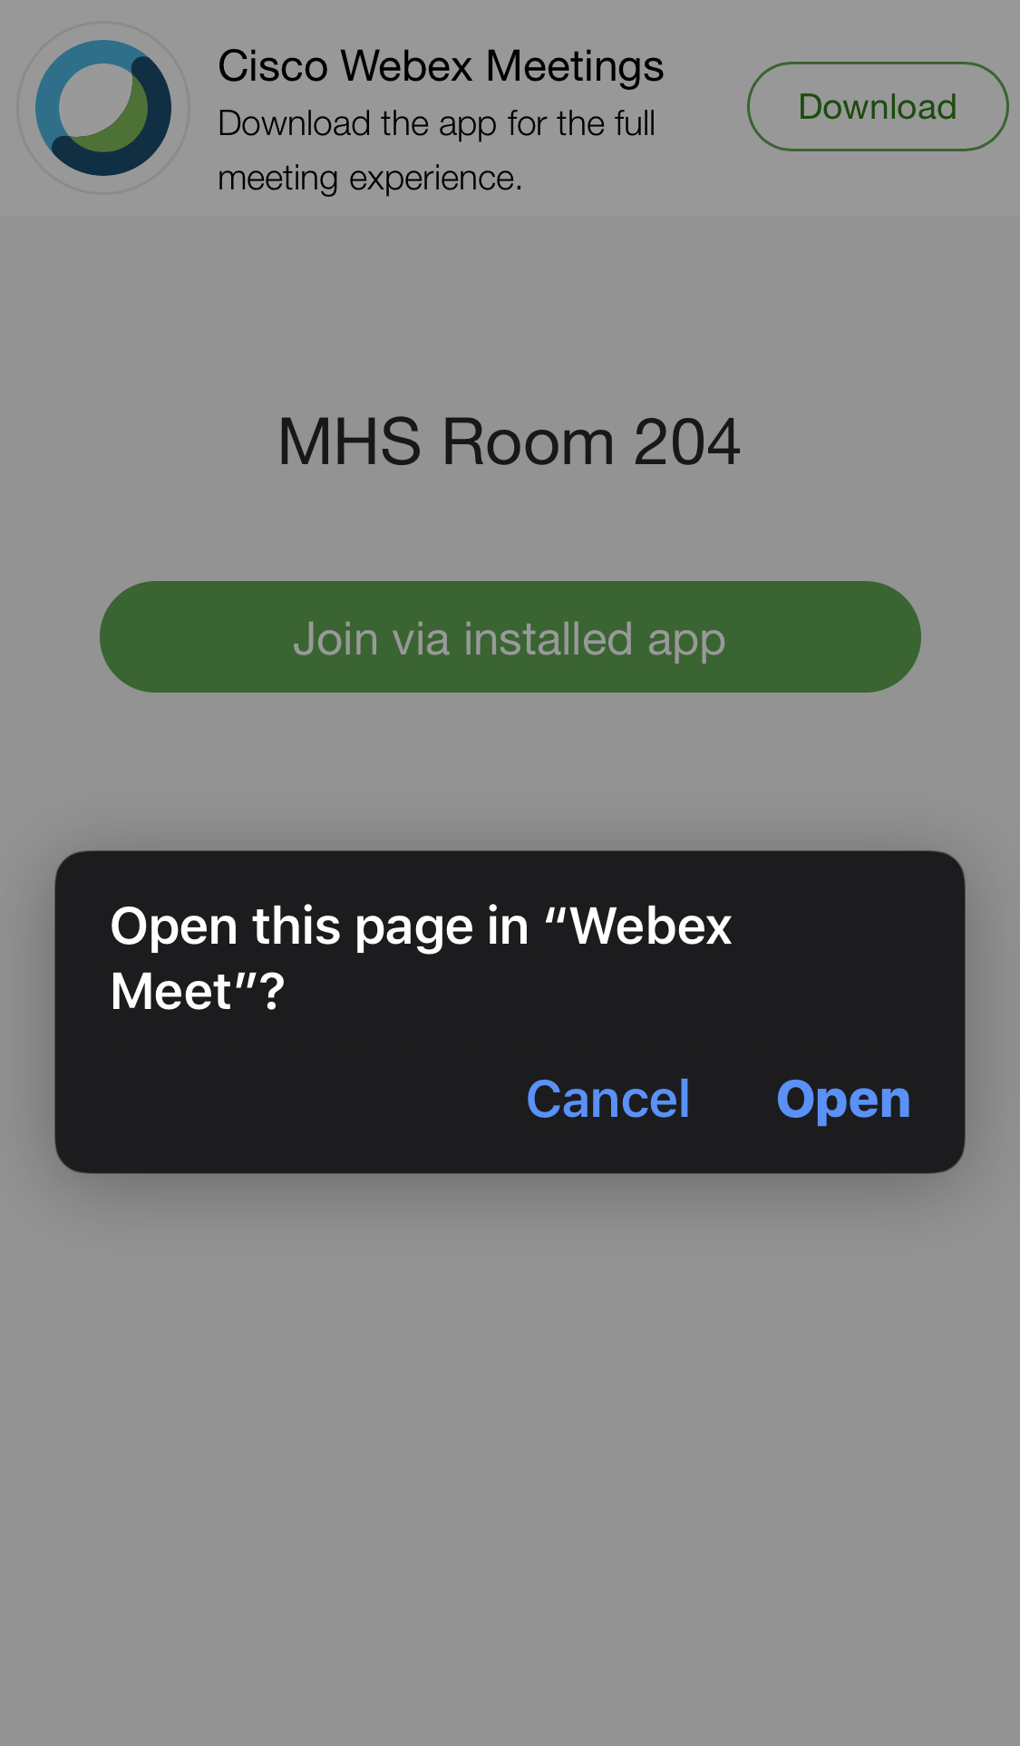
Click Open

